Slide 1
Māori Quiz Documentation
Thomas Wilson

Slide 2
Māori Quiz
Link to GitHub Repository: https://github.com/twschool/Assessment
Links to Trello board / project management tools: Māori quiz | Trello
Link to final version of your program: https://github.com/twschool/Assessment/blob/main/finished_program_v1.py
Ensure you have made these links ‘public’ so that they are open to anyone, including the marker. The link to your program is the final outcome of this whole project – your finished program.

Slide 3
Describe relevant Implications 1:
Additional rows can be added by clicking in the last cell and then using the Tab key
Relevant implication | Describe the implication and give an example
Functionality | Functionality is about guaranteeing that the program works as expected. It should work for expected, boundary, and unexpected cases or inputs. For example, if my program asks the user to answer a multiple-choice question is should work for the expected inputs like “A” “B” “C” or “D” and should tell the user to “Type a valid answer” if an answer is not any of the above and is a unexpected input it should not crash if the user enters something invalid like “0” or “q”. My program needs to tell the user that the input is invalid and either pass or repeat the input question.
Usability | Usability is about how easily the end user can get the program to do what it is supposed to do. It deals with issues like making instructions or error messages clear and easy for users to read and understand. It is important to minimize or eliminate any frustration that the end user might encounter using your program.
Notes:
Additional rows can be added by clicking in the last cell and then using the Tab key

Slide 4
Describe relevant Implications 2:
Relevant implication | Describe the implication and give an example
Future proofing | Future proofing is about making a program which is flexible, adaptive and easy to modify later if necessary. The code needs to be well set out and commented so that another programmer can make changes easily at some future time. It is important not to have a massive string of code and rather an organized structure. This will be helpful for someone who wants to modify my code in the future because they need to be able to understand the purpose and reasoning behind different parts of the code. Also, its important to use constant variables rather than hard coded ones to minimize the number of places where changes need to be made as to keep the code simple and easy to modify at a future date.
Copyright | Copyright is about using someone else’s work without proper credit or permission. My code needs to be unique and not stolen from someone else. I must take into account that individuals can accidently code the same thing as there are only a limited number of solutions to each problem therefore it can be ok if some of my code matches someone else as long as my code as a whole isn’t stolen from another person.
Notes:
Additional rows can be added by clicking in the last cell and then using the Tab key

Slide 5
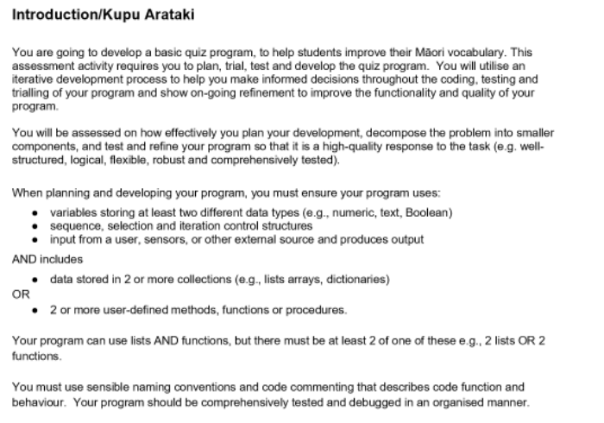
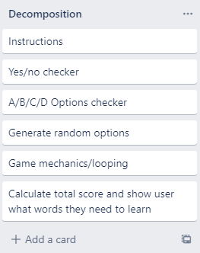
Decomposition:
Paste screenshots of your initial Trello board / task decomposition on this slide. If you have a long list, you might need to break it up into several slides.
Notes:
Paste screenshots of your initial Trello board / task decomposition on this slide. If you have a long list, you might need to break it up into several slides.

Slide 6
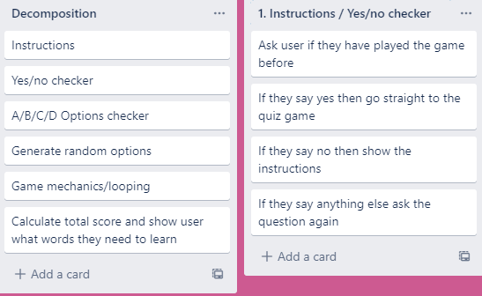
Component 1 –Instructions & Yes/No checker

Slide 7
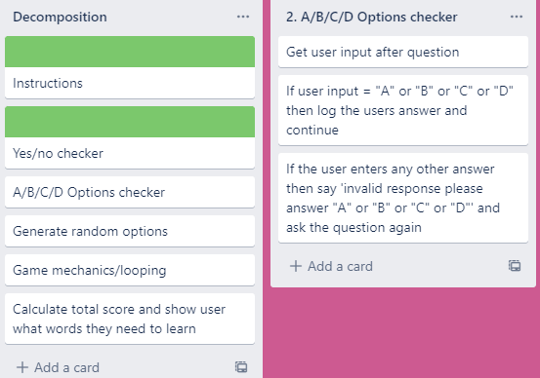
Component 2 – A/B/C/D Options checker

Slide 8
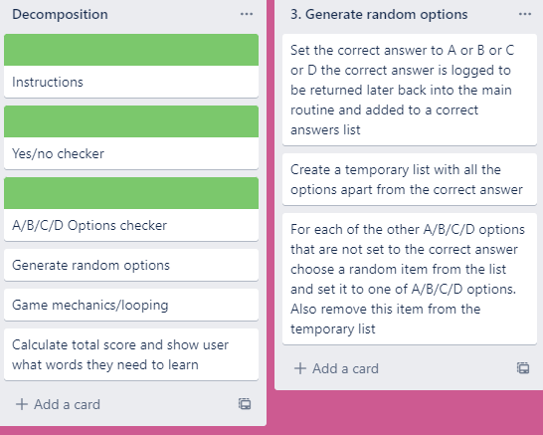
Component 3 – Generate random options

Slide 9
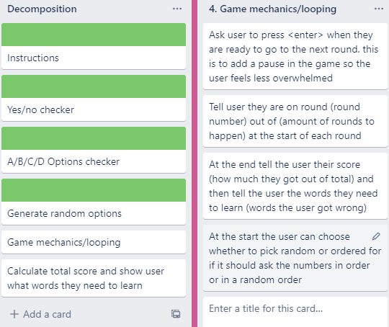
Component 4 – Game mechanics & Looping
Notes:
Additional rows can be added by clicking in the last cell and then using the Tab key

Slide 10
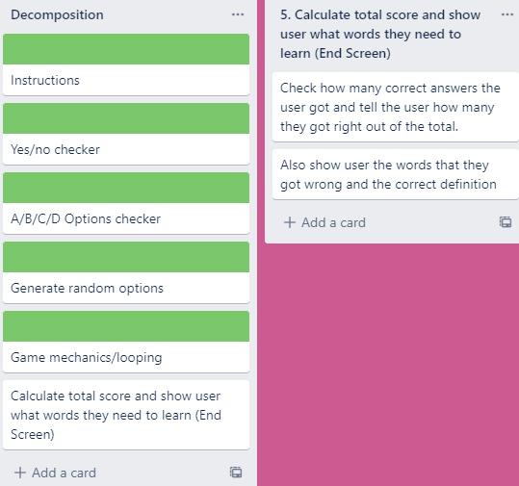
Component 5 –Ending Screen

Slide 11
Yes/No checker- Test Plan
Additional rows can be added by clicking in the last cell and then using the Tab key
Test Cases - input | Expected output
Yes | Program continues
Y | Program continues
yes | Program continues
No | Program continues
N | Program continues
Maybe | Please enter either “Yes” or “No”
Notes:
Additional rows can be added by clicking in the last cell and then using the Tab key

Slide 12
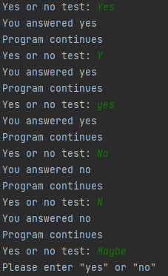
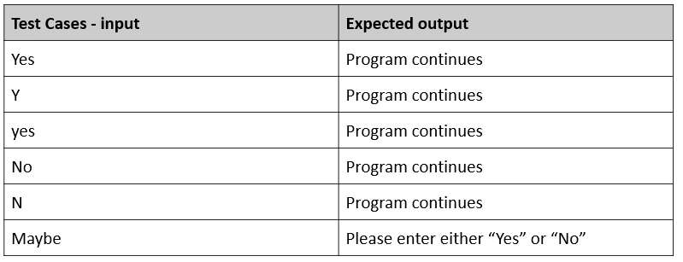
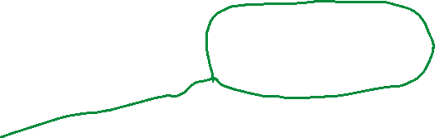
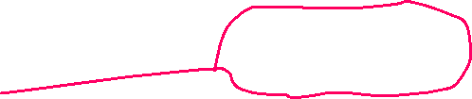
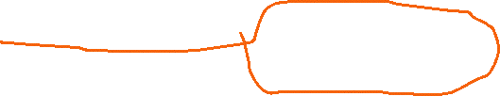
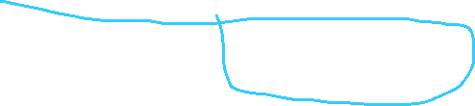
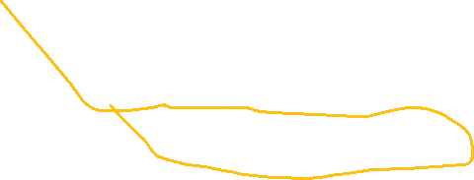
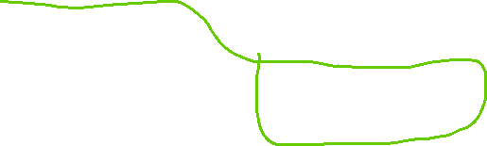
Yes/no checker test results
All test cases worked as expected

Slide 13
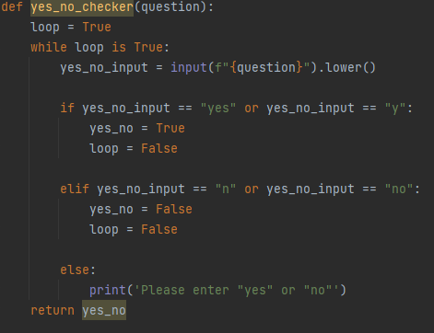
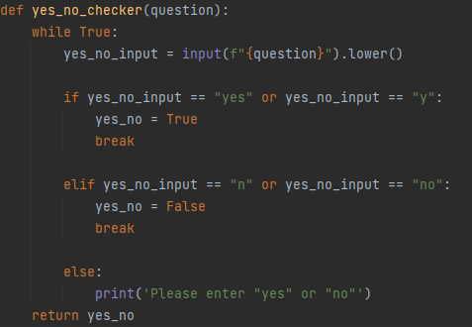
Yes/No checker - Trialling
Different methods trial yes_no_check_v2.py | Trialed having different ways to use a while loop (see images below) method 1 and method 2 can both do the same thing. I chose method 2 because there was less lines of code and the computer didn’t need to check a variable every time it looped which made the code more efficient and the more obvious choice.
Method 1 (13 lines)
Method 2 (12 lines)
Notes:
NOTE: Trialling needs to happen for at least 2 of your components but is not necessary for ALL components.
Trialling is not the same as testing. Trialling is about finding different ways of building the same component. Show evidence of your trialling here. Select one of your trials for further development and give reasons for your choice.

Slide 14
Generate random options- Trialling
Trial 1 generate_random_options_v1.py | Trialed having the code not as a function in this version
Trial 2 generate_random_options_v2.py | In this version (“generate_random_options_v2.py”) I changed the instructions into a function so there was less code in the main routine and so it would be easier for people in the future to change the instruction code. If the instructions needed to be displayed again the function could be called easily.
Notes:
NOTE: Trialling needs to happen for at least 2 of your components but is not necessary for ALL components.
Trialling is not the same as testing. Trialling is about finding different ways of building the same component. Show evidence of your trialling here. Select one of your trials for further development and give reasons for your choice.

Slide 15
Instructions - Test Plan
Additional rows can be added by clicking in the last cell and then using the Tab key
Test Cases - input | Expected output
Have you played before? Maybe | Please enter either “Yes” or “No”
Have you played before? Yes | Game starts
Have you played before? No | Show instructions, then start the game
Notes:
Additional rows can be added by clicking in the last cell and then using the Tab key

Slide 16

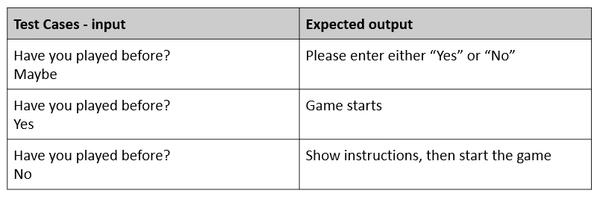
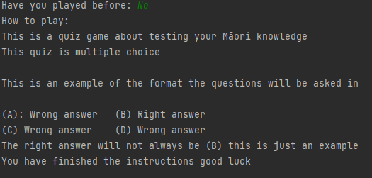


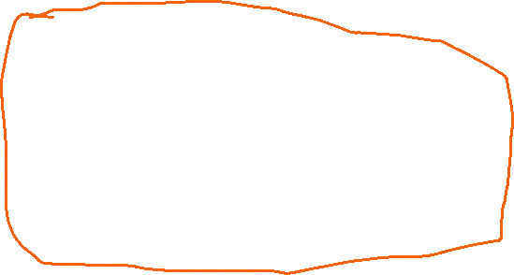
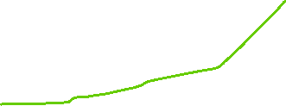




Instructions – Test results
All test cases worked as expected
Notes:
You must show the results of testing. For each component, include a screenshot proving it works. You can also include notes about each test.

Slide 17
A/B/C/D checker - Test Plan
Test Cases - input | Expected output
“Option a” | Please type a valid options ("A", "B", "C", or "D")
“1” | Please type a valid options ("A", "B", "C", or "D")
“Q” | Please type a valid options ("A", "B", "C", or "D")
“E” | Please type a valid options ("A", "B", "C", or "D")
A | Program continues
b | Program continues
c | Program continues
D | Program continues
Notes:
Additional rows can be added by clicking in the last cell and then using the Tab key

Slide 18
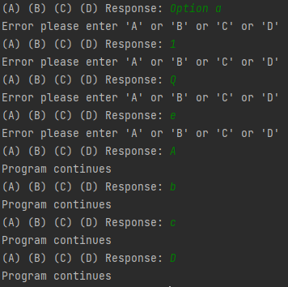
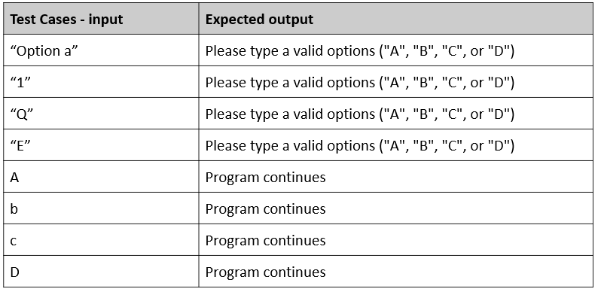
A/B/C/D checker - Test Results
All test results worked as expected
Notes:
Additional rows can be added by clicking in the last cell and then using the Tab key

Slide 19
Game mechanics and looping- Test Plan
Test Cases - input | Expected output
After instructions user is asked questions for each of the subject they choose | Game should go for 7 or 10 rounds. (numbers should go for 10 rounds) (days of the week should go for 7 rounds) Each round the round number is displayed out of the total number of rounds. Each round a random questions is picked from the chosen subject (weeks or numbers). After all the questions have been answered the game tells you which questions you got wrong.
Notes:
Additional rows can be added by clicking in the last cell and then using the Tab key

Slide 20
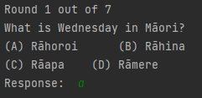
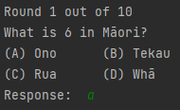
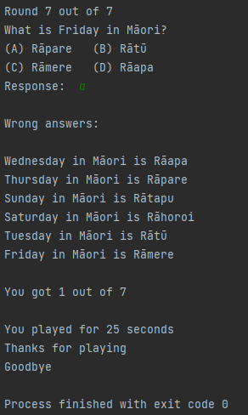
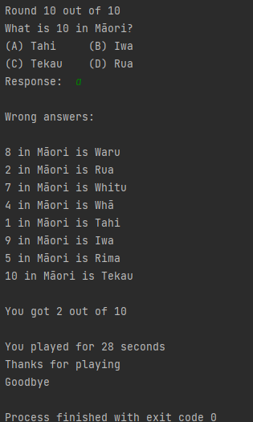
Game mechanics and looping- Test results
For numbers round starts at round 1 out of 10
For days of the week round starts at round 1 out of 7
For days of the week round finishes at round 7 out of 7 and wrong answers are displayed
For numbers round finishes at round 10 out of 10 and wrong answers are displayed
Notes:
Additional rows can be added by clicking in the last cell and then using the Tab key

Slide 21
Assembled Outcome 1 – Test plan
Test Cases - input | Expected output
Run program Played before = Maybe Played before = No | Welcome message displays Invalid answer please answer “Yes” or “No” Instructions display
Do you want to be tested on: (1): Numbers (2): Days of the week: i 0.5 0 1 2 | Question asked at start Please answer either "1" or "2" Please answer either "1" or "2" Please answer either "1" or "2" Program continues to first question of numbers Program continues to first question of days of the week
Notes:
Show testing for your assembled outcome below. This should include a test plan followed by screenshot proof.

Slide 22
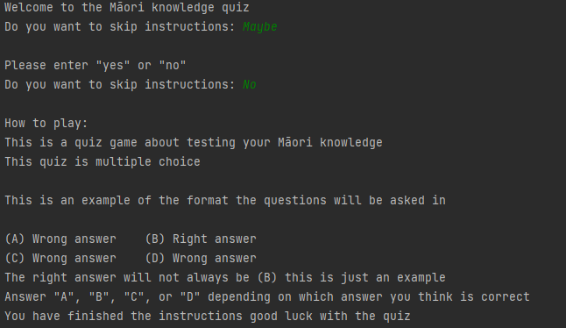
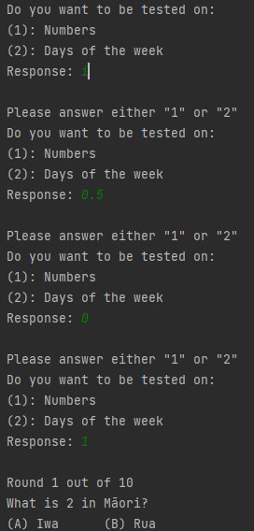
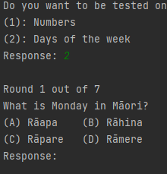
Assembled Outcome – Testing 1
Worked as expected – results produced
Match those in the plan on the preceding page
Notes:
Show testing for your assembled outcome below. This should include a test plan followed by screenshot proof.

Slide 23
Assembled Outcome 2 – Test plan 1
Test Cases - input | Expected output
Answer “A” to all rounds for numbers | For each round Round number out of 10 is displayed Random question asked that hasn’t been asked yet At end: Number of questions out of 10 user got correct Wrong answers displayed
Answer “A” to all rounds for days of the week | For each round Round number out of 7 is displayed Random question asked that hasn’t been asked yet At end: Number of questions out of 7 user got correct Wrong answers displayed
Notes:
Show testing for your assembled outcome below. This should include a test plan followed by screenshot proof.

Slide 24
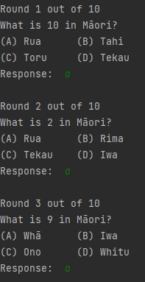
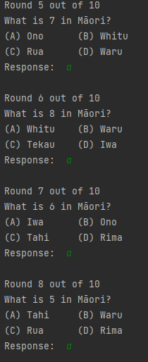
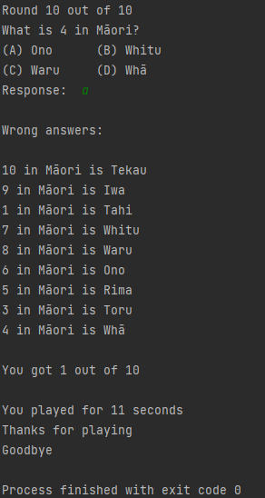
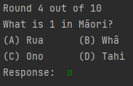
Assembled Outcome – Testing 2 part 1
Worked as expected – results produced
Match those in the plan on slide 23
Notes:
Show testing for your assembled outcome below. This should include a test plan followed by screenshot proof.

Slide 25
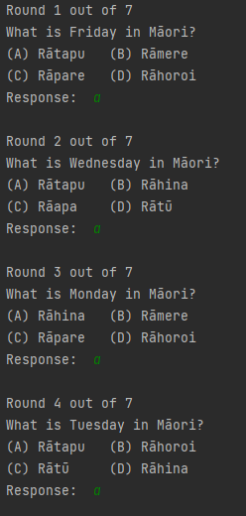
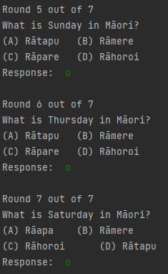
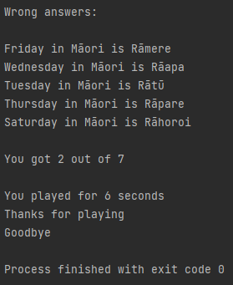
Assembled Outcome – Testing 2 part 2
Worked as expected – results produced
Match those in the plan on slide 23
Notes:
Show testing for your assembled outcome below. This should include a test plan followed by screenshot proof.

Slide 26
Assembled Outcome 3
Test Cases - input | Expected output
Answer a random things to all rounds for numbers. On the second loop of every question say a random of “a”, “b”, “c”, or “d”. | For each round First loop: User enters a random string of text or a random letter Program tells user to type a valid answer and loops Second loop: User enters “a”, “b”, “c”, or “d” Program continues onto next question
Answer a random things to all rounds for numbers. On the second loop of every question say a random of “a”, “b”, “c”, or “d”. | For each round First loop: User enters a random string of text or a random letter Program tells user to type a valid answer and loops Second loop: User enters “a”, “b”, “c”, or “d” Program continues onto next question
The game mechanics and looping component was in the last test plan so will not be included in this one: eg; round number displayed etc.
Notes:
Show testing for your assembled outcome below. This should include a test plan followed by screenshot proof.

Slide 27
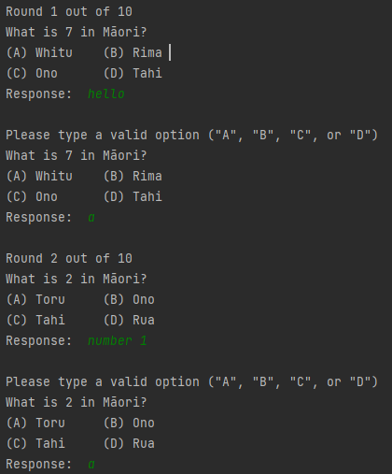
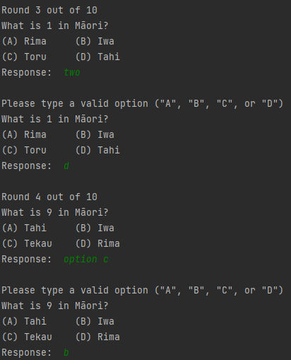
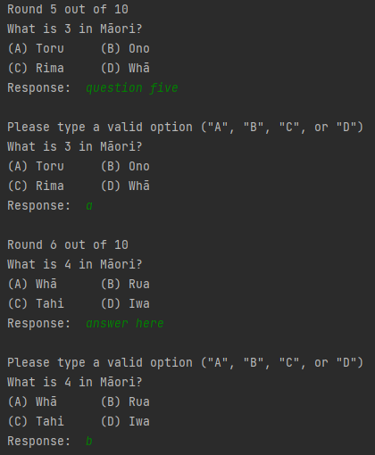
Assembled Outcome 3 – Testing part 1 (numbers)
Worked as expected – results produced
Match those in the plan on slide 26
Notes:
Show testing for your assembled outcome below. This should include a test plan followed by screenshot proof.

Slide 28
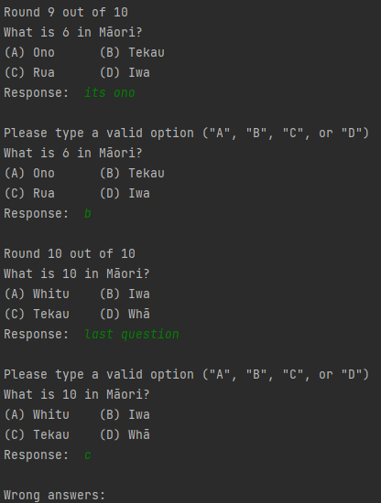
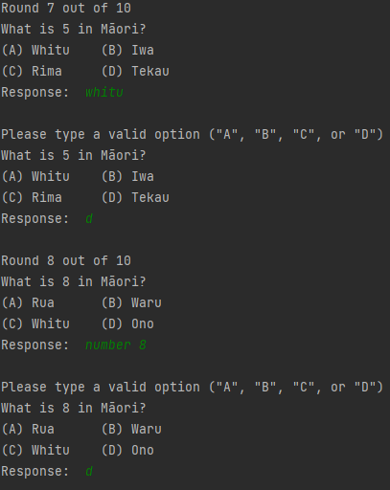
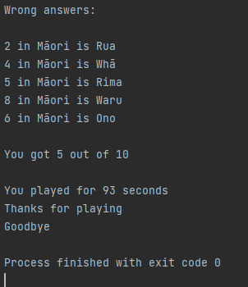
Assembled Outcome 3 – Testing part 2 (numbers)
Worked as expected – results produced
Match those in the plan on slide 26
Notes:
Show testing for your assembled outcome below. This should include a test plan followed by screenshot proof.

Slide 29
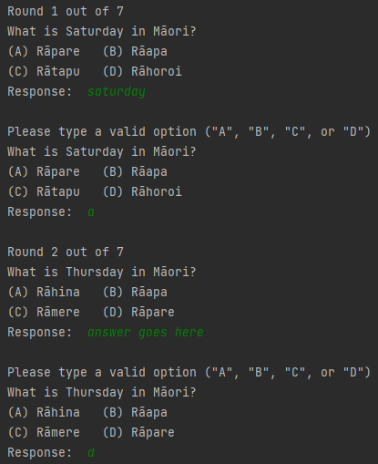
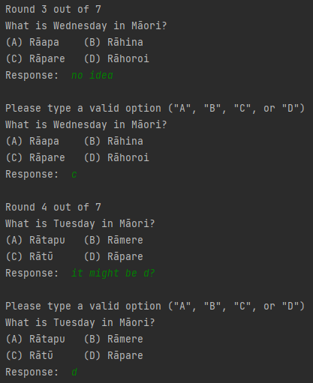
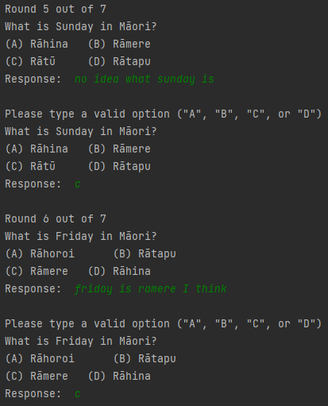
Assembled Outcome 3 – Testing part 1 (weekdays)
Worked as expected – results produced
Match those in the plan on slide 26
Notes:
Show testing for your assembled outcome below. This should include a test plan followed by screenshot proof.

Slide 30
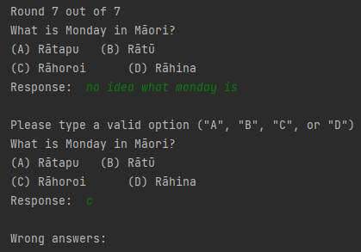
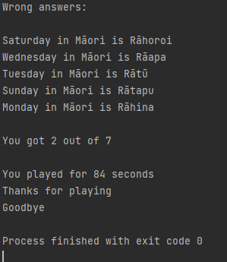
Assembled Outcome 3 – Testing part 2 (weekdays)
Worked as expected – results produced
Match those in the plan on slide 26
Notes:
Show testing for your assembled outcome below. This should include a test plan followed by screenshot proof.

Slide 31
Address relevant Implications:
Relevant implication | Explain how your final outcome addresses each implication
Functionality | I have excessively tested my outcome to make sure that the functionality implication has been addressed (i.e. it works for expected, unexpected, and boundary values).
Usability | The inclusion of optional instructions and clear error messages helps to make the outcome easy to use.
Future-proofing | I avoided the use of literals and used functions throughout my code to make it more flexible and easier to modify in the future if necessary. The code is well set out and commented so that another programmer can change the program easier at any future time.
Copyright | I coded every component and the program as a whole myself and wrote every question of the quiz myself. I avoided “borrowing” peoples code off the internet and took a unique approach to some of the problems I was faced with to minimize the risk of having similar code to another individual. Taking these steps also helps my code stand out while not violating any copyright laws.

Slide 32
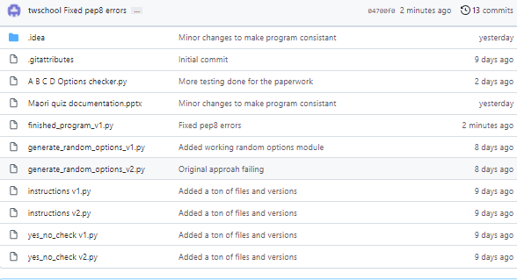
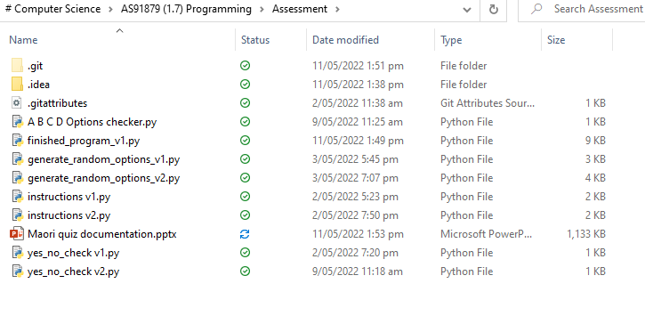
Version Control Evidence:
Your version control evidence should go here. This could be in the form of screenshots (both of your GitHub repository as well as your local project folder) as evidence of your incremental development.
<- (left): Local (OneDrive) directory
Project saved in GitHub repository (right) ->
Notes:
Your version control evidence should go here. This could be in the form of screenshots (both of your GitHub repository as well as your local project folder) as evidence of your incremental development.

Slide 33
Final Discussion:
While developing this program, I planned, tested and trialed its individual components and then later as a whole working game.
By decomposing the problem, I was able to plan my program efficiently and was able to focus on creating and testing small chunks of code.
Each of these chunks was thoroughly tested during and after construction.
By testing. I was able to find and fix the flaws in my program before combining them into the full program.
Having volunteers (classmates, and family) test my program enabled me to further improve it's functionality and get ideas about how to make it better which raised the reliability and quality of the finished program.
User feedback enabled me to look at the program from a non-programmer's point of view. This, combined with the information I got from the earlier planning, testing, and trialing, enabled me to produce a high-quality outcome. I tested my code using the built in pycharm pep8 checker and http://pep8online.com/ to make sure that it met the conventions regarding spacing and layout (see next slide).
Notes:
Discuss how the information from planning, testing and trialling of components assisted in the development of a high-quality outcome.

Slide 34

Evidence of meeting pep8 requirements

Slide 35
End user feedback
Note: My target audience is school students which made up 100% of my test group
At the start of development, I asked students what type of quiz would be best to make. Most of them responded “multiple choice quiz” as you can easily mistype an answer and get the whole question wrong and this would also make it easier for my end user as they only had to type one letter and not the whole answer which could easily be misspelled.
While developing this program I let multiple diverse groups of people test my program
I tested the program with many users in my Te Reo Māori class and they thought it was very good and they offered no bad feedback. Most of the people who helped test got 10/10 as they were in my Māori class and the quiz was a Māori quiz. I also tested my program with computer science classmates who thought it was good despite them getting 1-4 questions right out of 10 and finishing the quiz in less than 30 seconds. My end user feedback helped me established that my program was fit for my intended end user and purpose as no critical feedback was given.
I also got some of my friends to type random letters on the keyboard as an answer to some of the questions to see if my program would break (it didn’t)

